Slide 1
Socket Programming
Computer Network
Project 1

Slide 2
What is Socket?
A host-local, application-created, OS-controlled interface (a “door”) into which application process can both send and receive messages to/from another application.
Socket is an API to use internet.
controlled by
application
developer
controlled by
application
developer
process
process
socket
socket
TCP with
buffers,
variables
TCP with
buffers,
variables
controlled by
operating
system
controlled by
operating
system
Internet
host or
server
host or
server

Slide 3
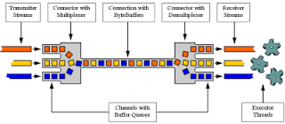
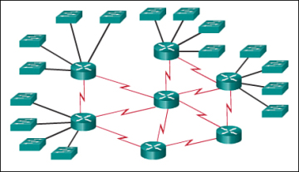
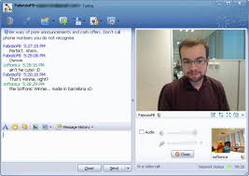


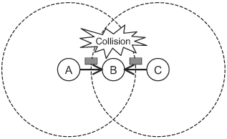
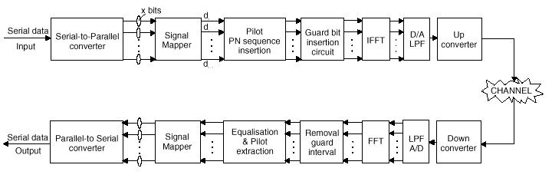
Why do we need socket?
Layering

Slide 4
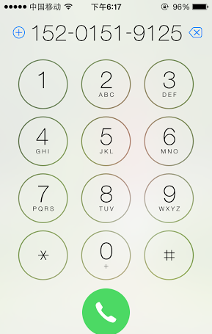
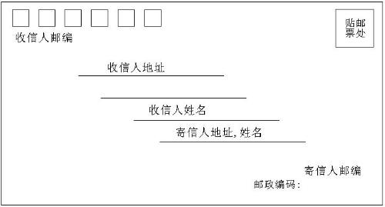
Socket Identification
Socket | Mail | Call
Local Socket Address | Your Address | Your Phone Num.
Remote Socket Address | Her Address | Her Phone Num.
Protocol | Envelop | Radio
Socket?

Slide 5
Address
The address must identify the sender/receiver.
Identification of the host – IP Address
IPv4: 32bit, X.X.X.X, X:8 bit
IPv6: 128bit, Y:Y:Y:Y:Y:Y:Y:Y, Y:16 bit
Identification of the process – Port
0~65535
The five tuples to specify a socket:
(SrcIP, SrcPort, DstIP, DstPort, Protocol)

Slide 6
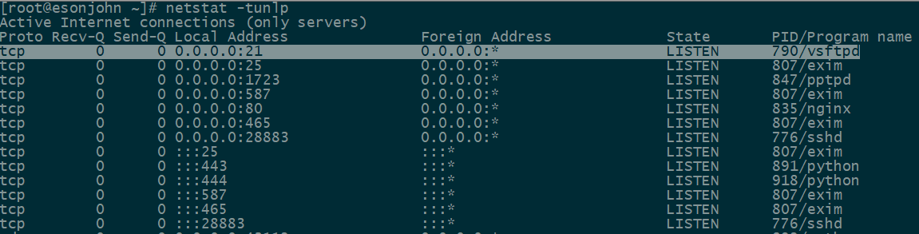
Port Usage
Popular applications have “well-known ports”.
By convention, between 0 and 1023; privileged
E.g., port 80 for HTTP, 25 for SMTP, 21 for FTP
For more, refer to Wikipedia.
Custom client gets an unused “ephemeral” port.
By convention, between 1024 and 65535.

Slide 7
Protocol
Socket at Transport Layer.
UDP
TCP

Slide 8
A Preview on UDP
UDP Service: Best-effort transfer of groups of bytes (“datagrams”) between client and server.
Datagrams == Groups of bytes
port + length + checksum
Address information: port
No ack: package loss
No sequence: out-of-order
Best-effort == unreliable
Connectionless: You have no idea whether the packet is received, unless notified by the receiver.
Lightweight and fast
Multi-media
Routing protocol
DNS

Slide 9
A Preview on TCP
TCP Service: Reliable transfer of byte-stream from one process to another.
Reliable:
Ack
Connection oriented and maintenance of the connection
Byte-stream
A sequence of characters that flow into or out of a reliable process(stdin, stdout, socketin, socketout)
Seq: In order
Build a reliable “pipe” on the unreliable network.

Slide 10
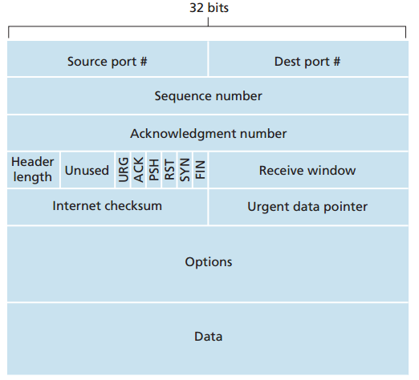
A Preview on TCP
Segment Structure
Seq number, Ack number, Rcv Window: Reliable transmission

Slide 11
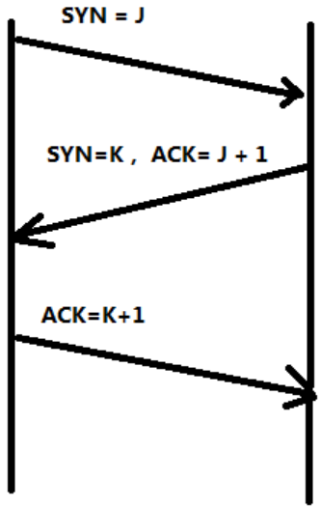
A Preview on TCP
Connection setup: 3-way handshake
Client notify server with SYN indicator
Server acknowledge client with SYN/ACK indicator
Client acknowledge server with ACK indicator
Client
Server

Slide 12
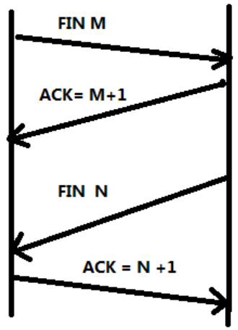
A Preview on TCP
Connection termination: 4-way handshake
Client notify server with FIN indicator
Server acknowledge client with ACK indicator
Server notify client with FIN indicator
Client acknowledge server with ACK indicator
Client
Server

Slide 13
Socket Programming in C
Client
Server
socket
socket
bind
listen
Connection Request
connect
accept
write
read
read
write
Waiting for next
connection Request
EOF
close
read
close

Slide 14
Socket Programming in C
Create a socket
int socket(int domain, int type, int protocol)
Domain: ipv4/ipv6
Type: SOCK_STREAM/SOCK_SEQPACKET/…
Protocol: TCP/UDP/…
Client/Server Establish a connection
int connect((int sockfd, struct sockaddr *serv_addr, int addrlen)
sockfd: socket handler
serv_addr: server address
addrlen: serv_addr length

Slide 15
Socket Programming in C
Byte Ordering
unsigned long int htonl(unsigned long int hostlong)
unsigned short int htons(unsigned short int hostshort)
unsigned long int ntohl(unsigned long int netlong)
unsigned short int ntohs(unsigned short int netshort)
IP Addresses
int inet_aton(const char *cp, struct in_addr *inp)
char *inet_ntoa(struct in_addr in);

Slide 16
Socket Programming in C
For TCP, Send Data
ssize_t write(int sockfd, const void *buf, size_t nbytes);
ssize_t send(int sockfd, const void *buf, size_t nbytes, int flags);
sockfd: socket handler
buf: data buffer
nbytes: write/send data length
flags: block/nonblock/…
For TCP, Receive Data
ssize_t read(int sockfd, void *buff, size_t nbytes);
ssize_t recv(int sockfd, void *buff, size_t nbytes, int flags);
For UDP, use
ssize_t sendto (int sockfd, void *buff, size_t nbytes, int flags, const struct sockaddr *dest_addr, int addrlen);
ssize_t recvfrom (int sockfd, void *buff, size_t nbytes, int flags, const struct sockaddr *src_addr, int addrlen);

Slide 17
Socket Programming in C
Server listening
Bind some port
int bind (int sockfd, struct sockaddr *my_addr, int addrlen)
sockfd: socket handler
my_addr: local listening address
addrlen: my_addr length
Define how many connections can be pending
int listen(int sockfd, int backlog)
sockfd: socket handler
backlog: maximum connections
Accept a new connection from a client
int accept(int sockfd, struct sockaddr *addr, int *addrlen)
sockfd: socket handler
addr: client address
addrlen: addr length

Slide 18
Socket Programming in C
Debug
perror(“socket error: ”)
prints "socket error: " + the error message.
printf("an error: %s\n", strerror(errno));
prints "an error: " + the error message from errno.

Slide 19
Other Tools
How to check if particular port is listening
Windows – use netstat
netstat -an
Linux – use nmap
nmap -sT -O localhost
bind status can indicate whether port is in use
Not knowing what exactly gets transmitted on the wire
Use tcpdump or Ethereal (www.ethereal.com)
Check RFCs if in doubt about protocols.
RFC 959

Slide 20
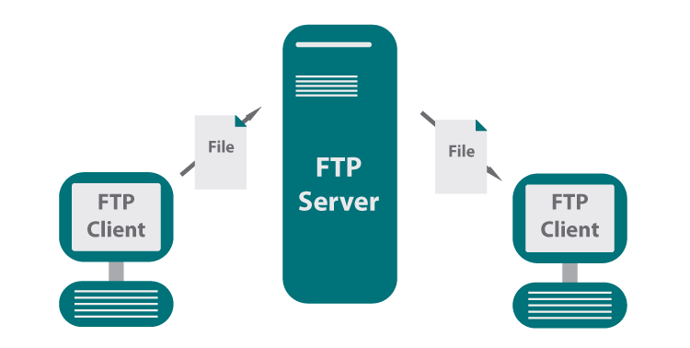
What is FTP?
A standard network protocol used for file download or upload between server and client on a computer network.

Slide 21
Commands in FTP
USER, PASS
login to server
RETR
download file from server
STOR
upload file to server
PORT, PASV
specify active/passive mode
MKD, CWD, PWD, LIST
manipulate directories on server
...(rfc 959)

Slide 22
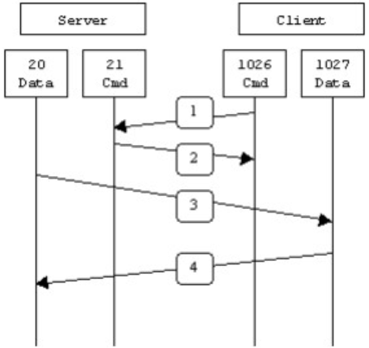
PORT Mode of FTP
PORT(Active Model)
Server monitor default control port 21
Client request control port N1 from OS
Client request data port N2 from OS and notify Server
Server setup connection between local 20 port and client N2 port
Data streams between server 20 port and client N2 port

Slide 23
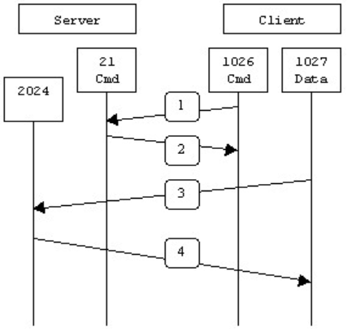
PASV Mode of FTP
PASV(Passive Model)
Server monitor default control port 21
Client request control port N1 from OS
Client request data connection from Server on N1
Server request data port N2 from OS and notify Client
Client request data port N3 from OS
Client setup connection between local port N3 and server port N2
Data streams between server port N2 and client port N3

Slide 24
Project Description
Goal
Learn to setup communications between PCs with socket.
To be familiar with FTP protocol;
To be familiar with network protocol stack;
Learn to build client/server applications that communicate using sockets.

Slide 25
Task1: UDP Programming
Read the sample code
Choose any language you are familiar with(C, C#, Java, node, Python).
Modify the UDP Server and Client According to the homework guide.
Questions:
How to write a chat programming (two clients chat with each other) with UDP?

Slide 26
Task2: Implementing FTP Server
Must use the Berkeley Socket API(Linux) and write your server in C;
Must serve files from a designated directory on your system to clients making requests on a designated TCP port;
Must handle USER, PASS, RETR, STOR, QUIT, SYST, TYPE, PORT, PASV, MKD, CWD, PWD, LIST, RMD, RNFR, RNTO commands;

Slide 27
Task2: Implementing FTP Server
Handling invalid input reasonably and generating defensible error codes;
May not use any libraries containing code specifically designed to implement FTP functionality;
Transmit large files without blocking the server;
Resume transmitting after connection terminated;
Support connections from multiple clients;

Slide 28
Task3: Implementing FTP Client
You can write your client in your favorite programming language;
Must handle USER, PASS, RETR, STOR, QUIT, SYST, TYPE, PORT, PASV, MKD, CWD, PWD, LIST, RMD, RNFR, RNTO commands;
Able to log in a provided common server and download/upload files;
GUI;

Slide 29
Some Important Issues
Grading
UDP Programming (10%)
Implementation of FTP (70%)
Server (40%)
Client (30%)
Project Report (20%)

Slide 30
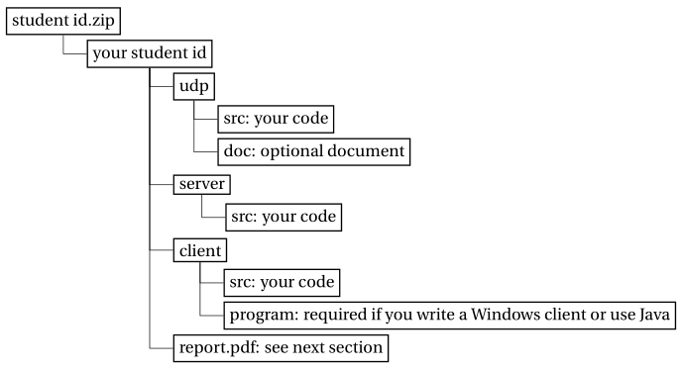
Some Important Issues
Submission
Source code for udp, server/client;
Executable file and how to run it;
Report: no longer than THREE pages.
Files are to be organized as follows:
Evaluation
Auto-grading program for FTP server.
Face-to-face check for FTP client.

Slide 31
Some Important Issues
Important Date
Start up: today (2019.9.25.)
Due date:
4 weeks later (2019.10.23.)

Slide 32
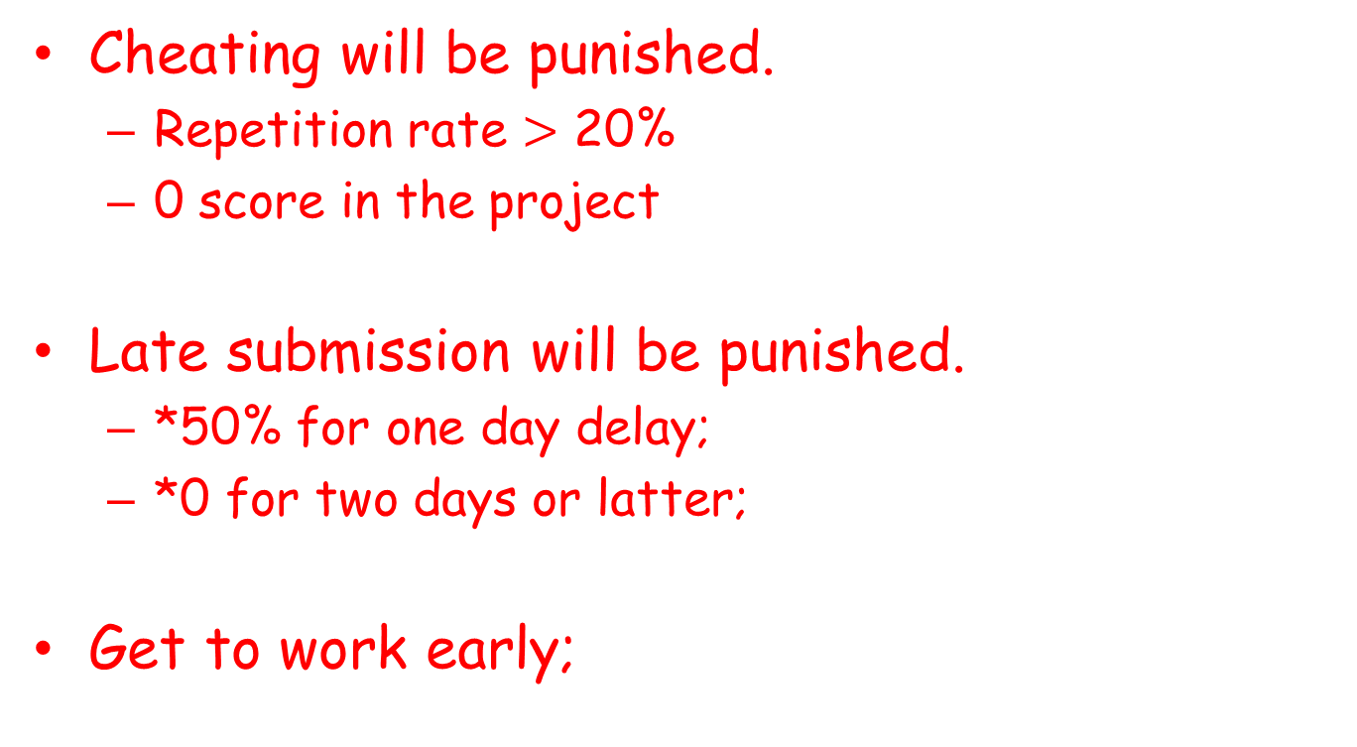
Some Important Issues
Cheating will be punished.
Repetition rate $>$ 20%
0 score in the project
Late submission will be punished.
*50% for one day delay;
*0 for two days or latter;
Get to work early;

Slide 33
Problems Emerged
Improper use of control/data socket(list, pwd)
Illegal design of command (PORT/PASV)
Fails to connect to standard FTP server
Follow RFC protocol
Security Issue
Fails to check username & password
cd ..
String Issue (\0)
Handle exceptions
Socket exception
I/O exception

Slide 34
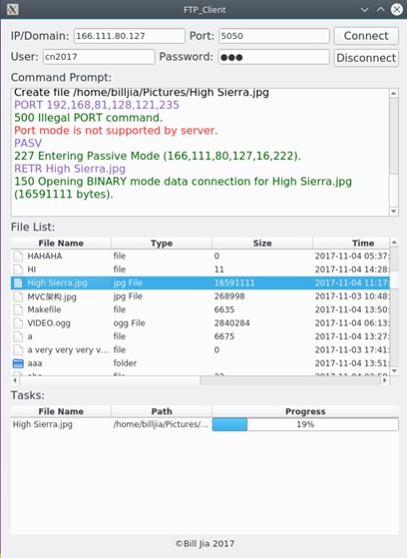
Outstanding Project
Student A

Slide 35
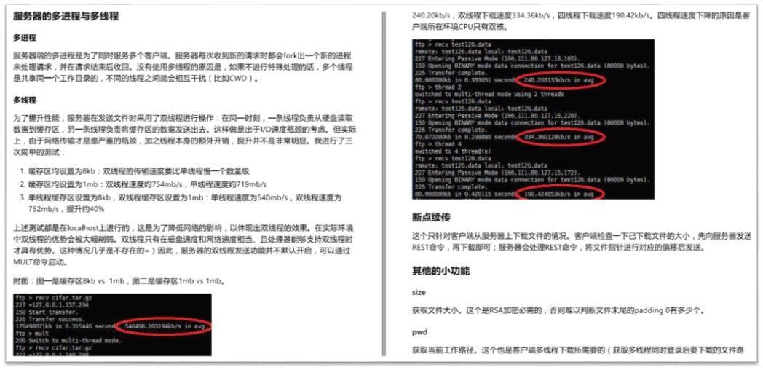
Outstanding Project
Student B

Slide 36
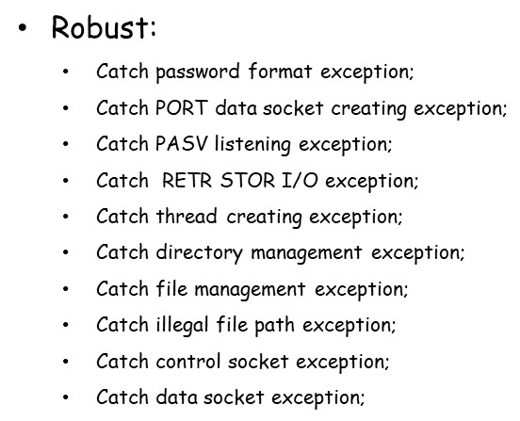
Outstanding Project
Student C

Slide 37
Q&A

